Slide 1
INFINITY MODEL
NOVEMBER 10, 2025

Slide 2
SKILL DEVELOPMENT
HTML
CSS

Slide 3
WHAT IS HTML?
HTML- HYPERTEXT MARKUP LANGUAGE.
IT IS A VERY SIMPLE AND EASY LANGUAGE. IT CAN BE EASILY MODIFIED.
IT IS PLATFORM INDEPENDENT AND CASE-INSENSITIVE LANGUAGE.
IT USED TO DESIGN CREATE WEB PAGE USING CSS.

Slide 4
WE CREATED ENTIRE WEB PAGE USING HTML AND CSS FOR SUBMISSION OF EXPERIMENT 4.
BASIC CODE OF HTML AND SUBMISSION OF EXPERIMENT 1.
DAY 1
DAY 2
DAY 3
15 mins
WE CREATED TABLE AND FORM USING HTML AND SUBMITTED EXPERIMENT 2&3.

Slide 5
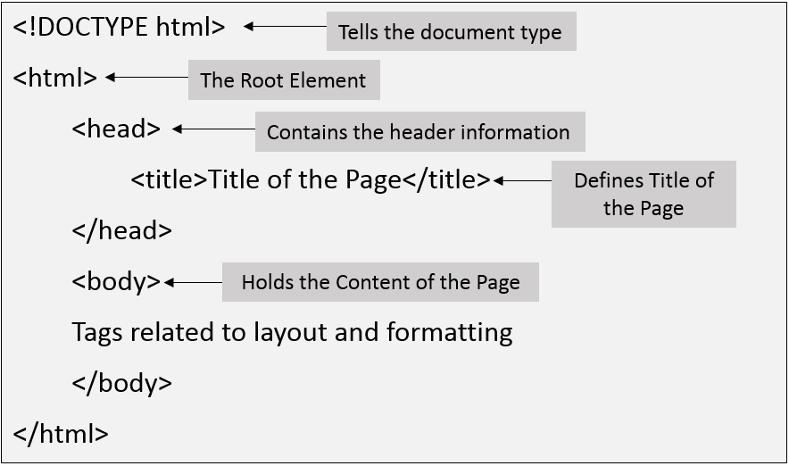
DAY 1
WE LEARNED STRUCTURE OF HTML AND PRACTICED HTML BASIC CODES.
STRUCTURE OF HTML:

Slide 6
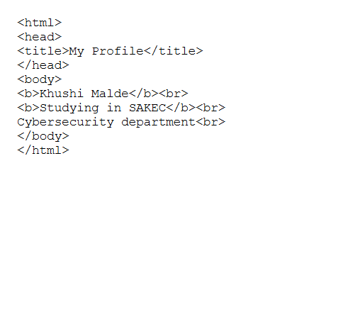
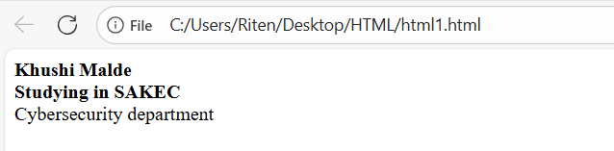
PROGRAM 1: CODE & OUTPUT
We understood the structure of HTML.
We used <b> tag for BOLD.
<br> TO BREAK LINE.

Slide 7
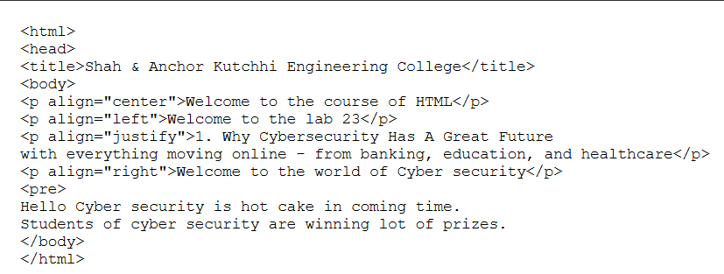
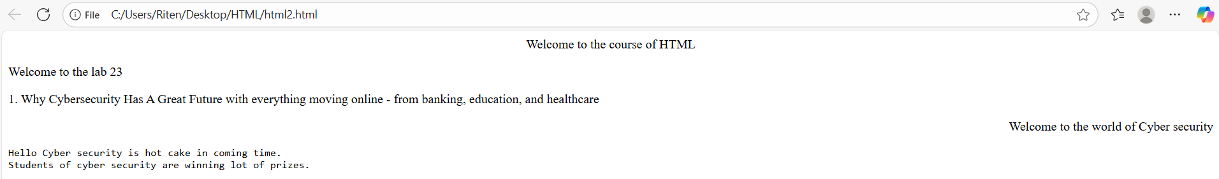
PROGRAM 2: CODE & OUTPUT
We used <p> tag for paragraph and <align> tag to align the text.
We used <align=”justify”> to align text evenly along both right and left margin.

Slide 8
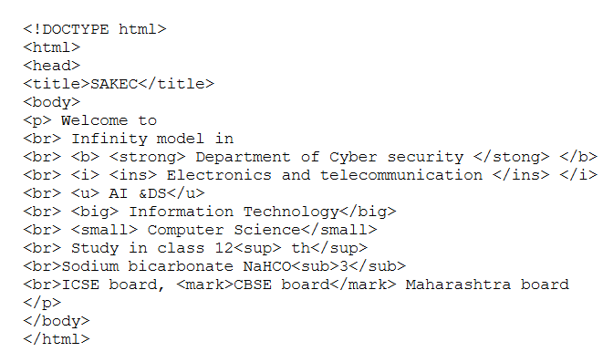
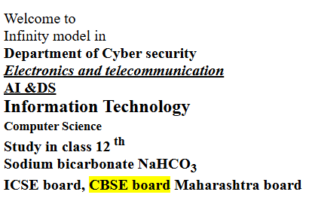
PROGRAM 3: CODE & OUTPUT
We used different types of font style tags like <strong>, <small>,<i>, <ins>,<small>, <sup> and <sub>.

Slide 9
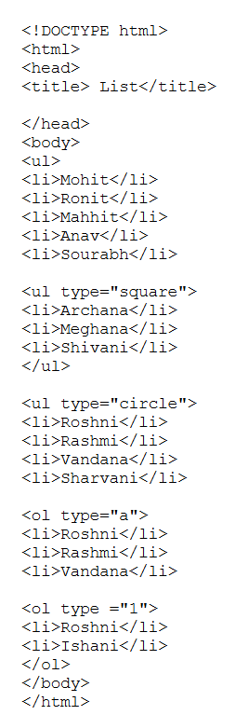
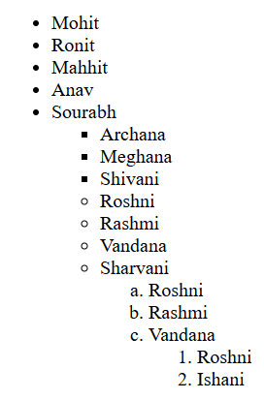
PROGRAM 4: CODE & OUTPUT
We used <ul>, <ol> and <li>
tag for unordered list, ordered list.

Slide 10
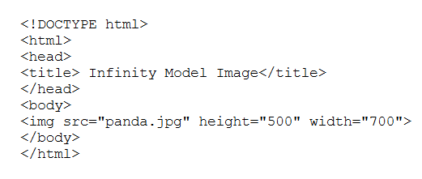
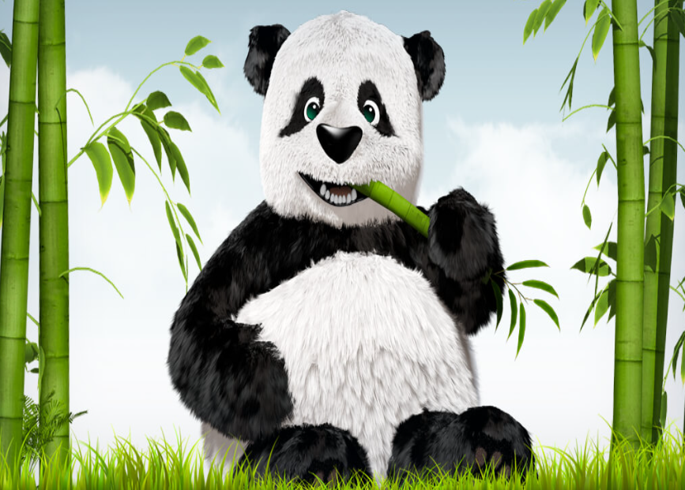
PROGRAM 5: CODE & OUTPUT
We used <img> to insert image and also increased its height and width .

Slide 11
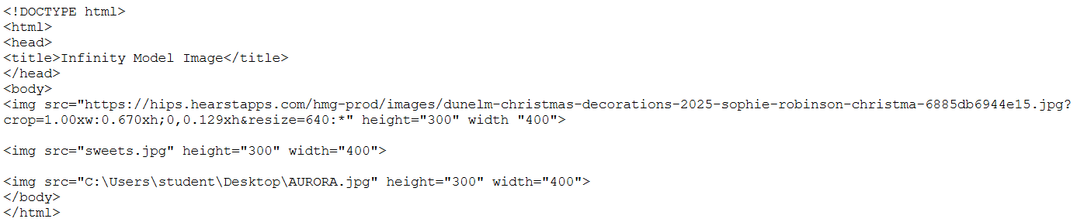

PROGRAM 6: CODE & OUTPUT
We used <img> tag to insert image by 3 ways.

Slide 12
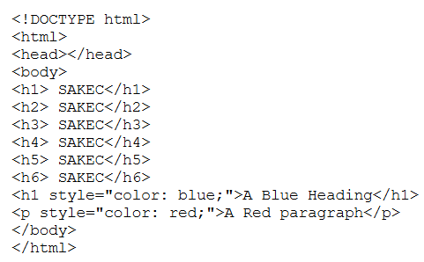
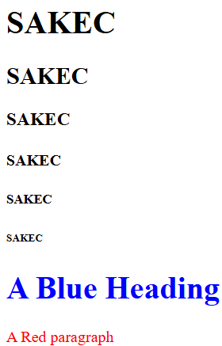
PROGRAM 7: CODE & OUTPUT
We used <h1> tag to insert heading with different size.
We also used styles tag.

Slide 13
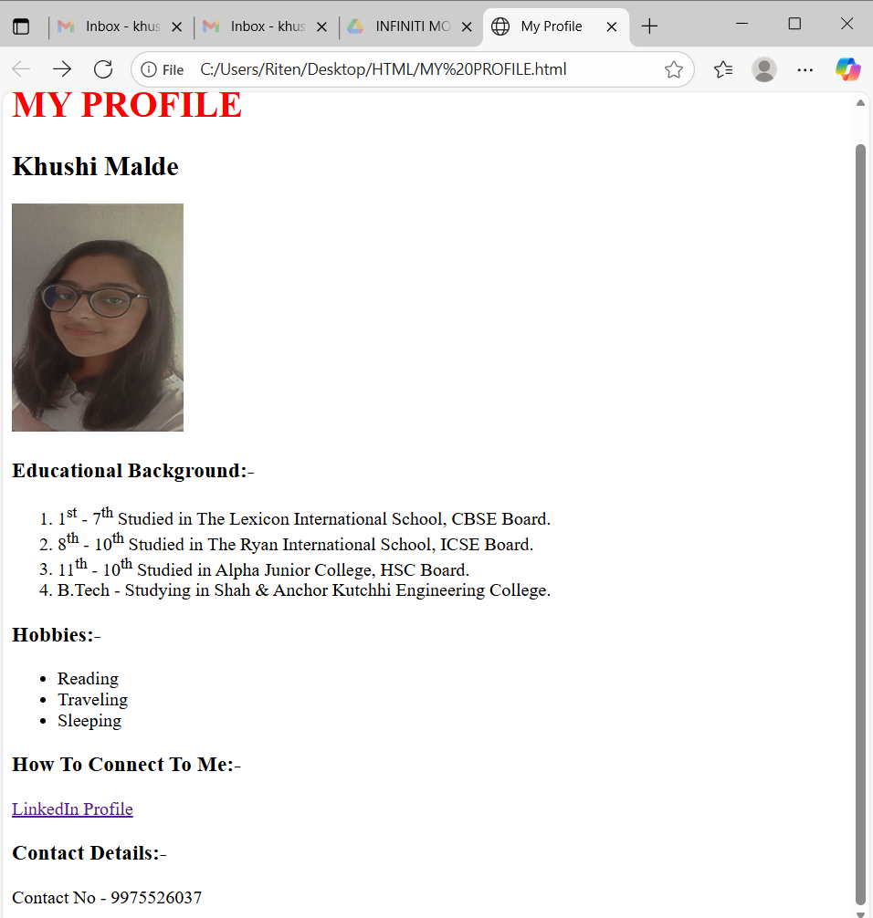
EXPERIMENT 1: OUTPUT
In exp 1 we created our profile using <img>, <ul>, <ol> tags and hyperlink

Slide 14
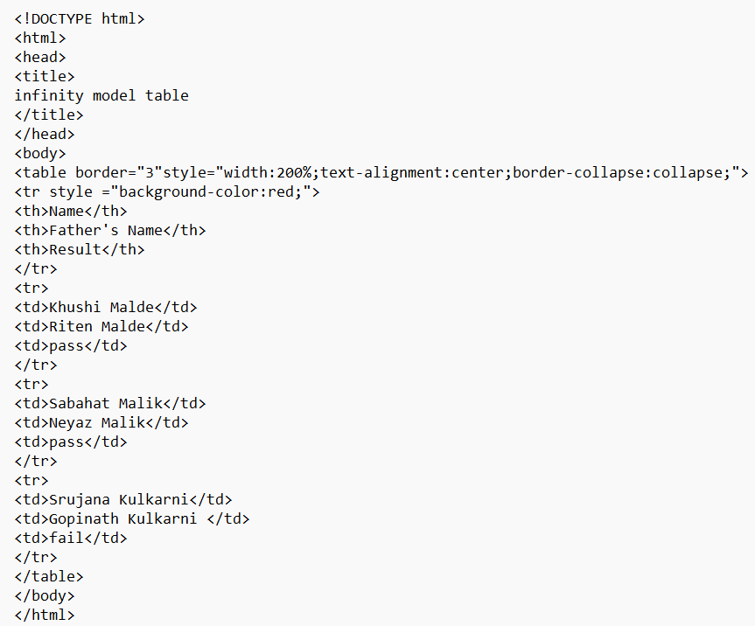
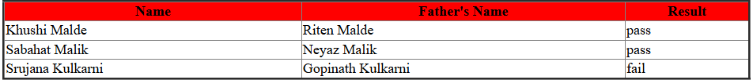
DAY 2
WE CREATED TABLE AND FORMS USING VARIOUS TAGS.
PROGRAM 9: CODE AND OUTPUT
We created table using <th>, <tr> and <td> tags.

Slide 15
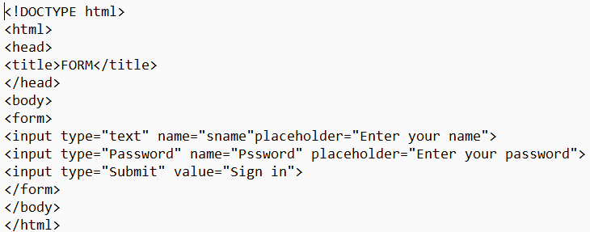

PROGRAM 10 : OUTPUT AND CODE
We created form using <form> tag

Slide 16
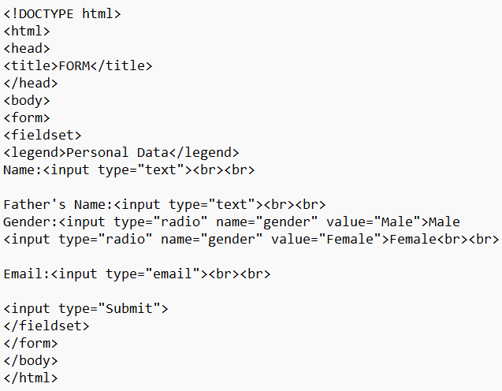
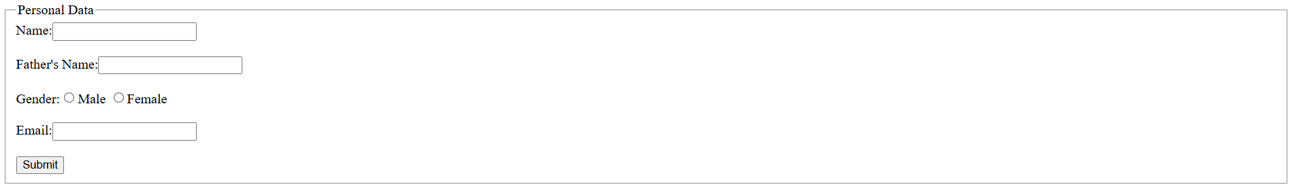
PROGRAM 11 : OUTPUT AND CODE
We created form using <form> tag .
We also used <fieldset> tag.

Slide 17
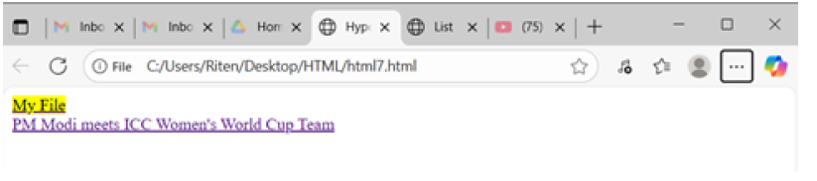
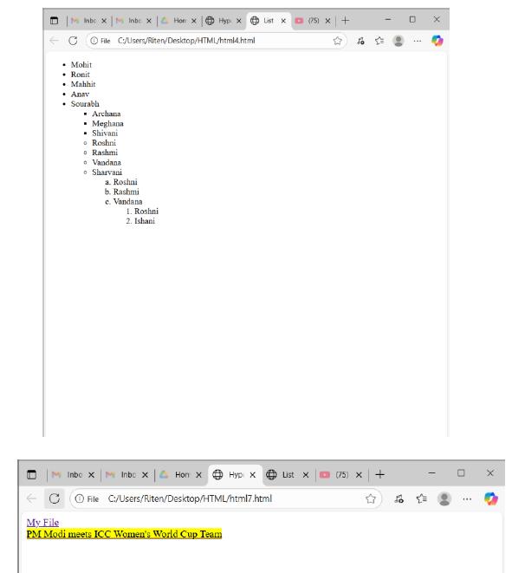
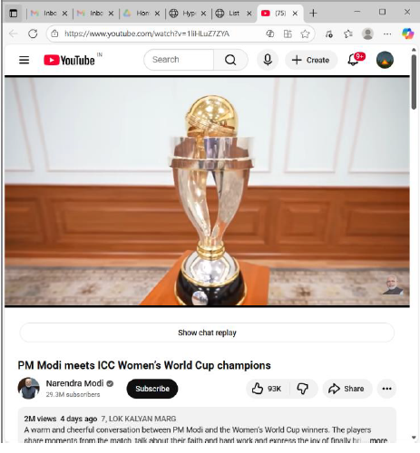
EXPERIMENT 2: OUTPUT
In exp2, we created a web page with hyperlinks to navigate from one page to another.

Slide 18
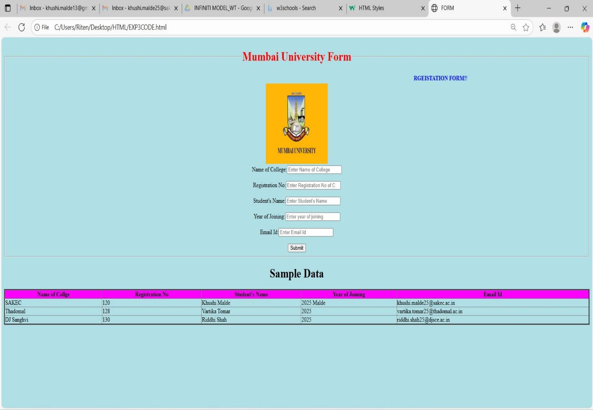
EXPERIMENT 3: OUTPUT
In exp3, we created a web page for registration form of Mumbai University with sample data including a image, form and table.

Slide 19
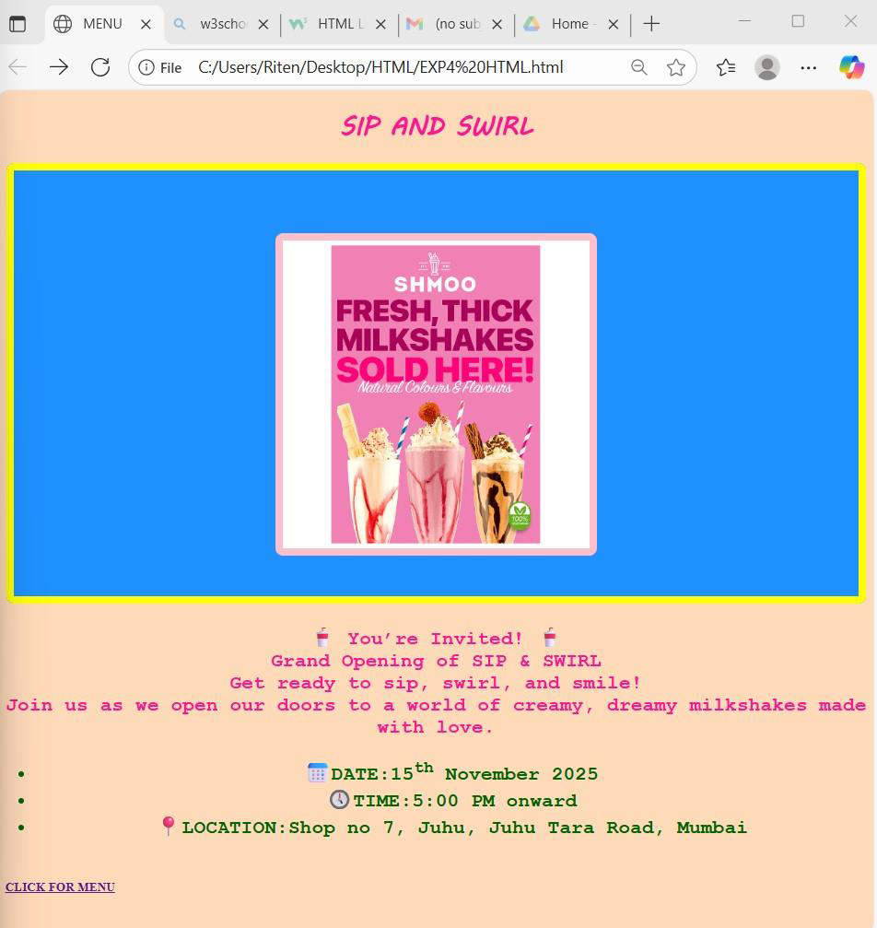
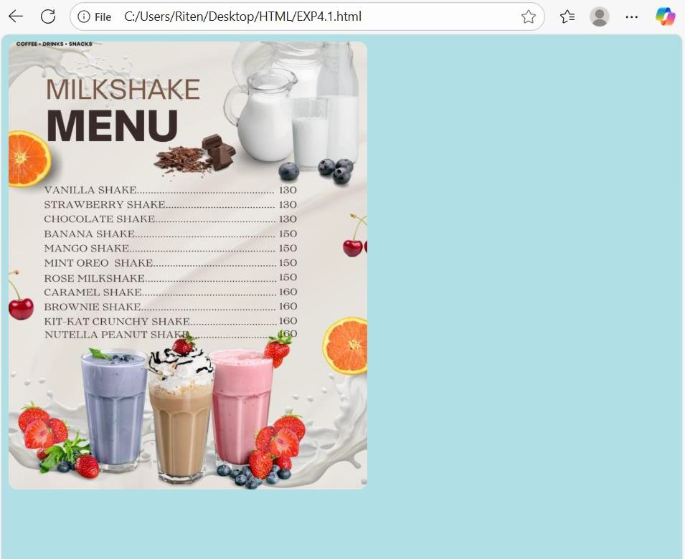
DAY 3 - EXPERIMENT 4: OUTPUT
In exp4, we created a web page using HTML & CSS including inline, internal and external styles. We also used hyperlink to navigate to different web page.

